Slide 1


Heart Disease Prediction Using Machine Learning
Skill Vertex : Feb batch
Domain: Data Science
Final Major Project,
Mentor: Akash Maurya
Team member:
1.Yash Tambat 3.Vishali Sudhakar 5.Maithre Sunitha
2. Harshana Sundaram 4.Dhanush Subramanian
6.Arya SS
1

Slide 2

INTRODUCTION
What is Heart Disease ?
: A type of disease that affects the heart or blood vessels. The risk of certain heart diseases may be increased by smoking, high blood pressure, high cholesterol, unhealthy diet, lack of exercise, and obesity. The most common heart disease is coronary artery disease (narrow or blocked coronary arteries), which can lead to chest pain, heart attacks, or stroke. Other heart diseases include congestive heart failure, heart rhythm problems, congenital heart disease (heart disease at birth), and endocarditis (inflamed inner layer of the heart). Also called cardiovascular disease.

Slide 3
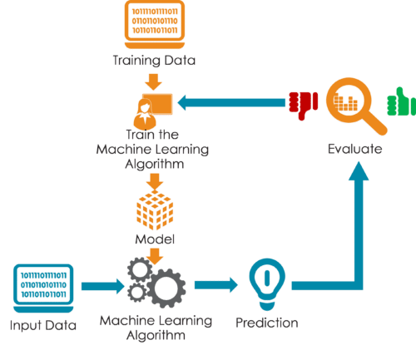

Slide 4
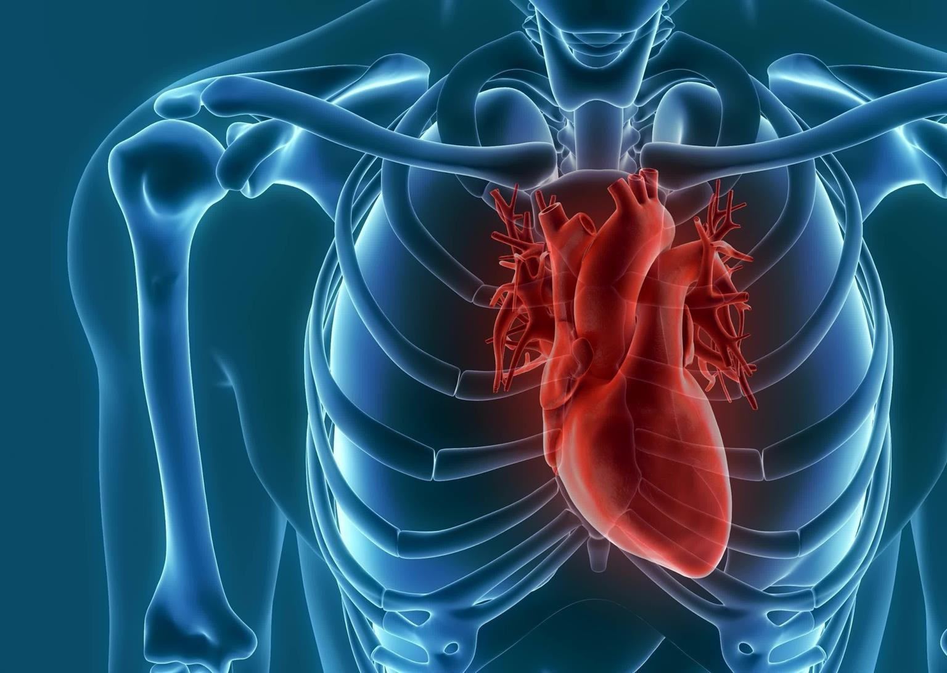

The Working of the Project

Slide 5

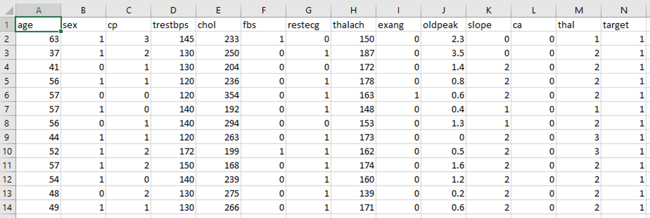
Dataset

Slide 6
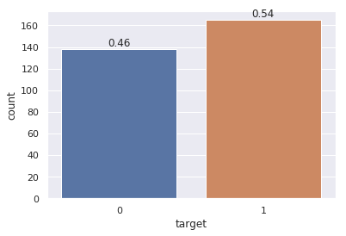
1
0
165
138

Slide 7
3 step process
Train the dataset
Compare the Algos
Split the dataset

Slide 8

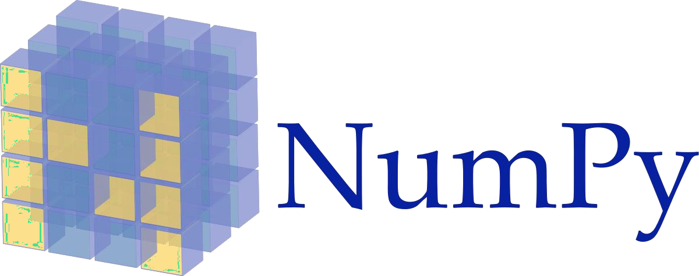




Slide 9
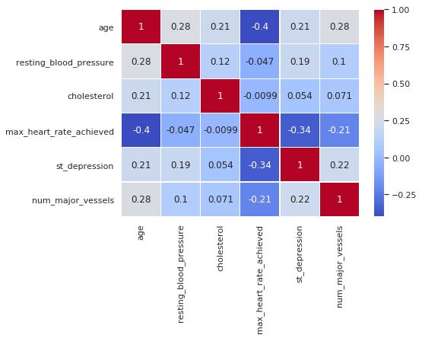
Correlation Plot

Slide 10
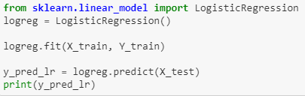
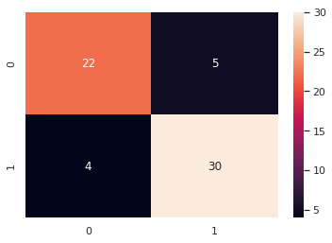
Logistic Regression
accuracy score : 85.25 %
Precision: 0.85
Recall is: 0.88
F-Score: 0.86

Slide 11
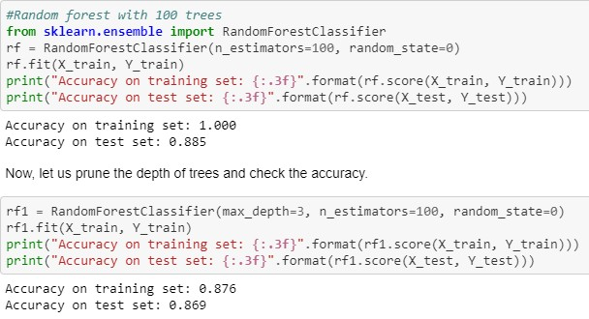
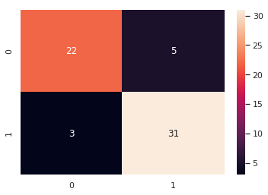
Random Forest
Precision: 0.86
Recall is: 0.91
F-Score: 0.88

Slide 12
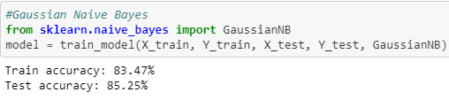

Naive Bayes
Precision: 0.83
Recall is: 0.91
F-Score: 0.87

Slide 13

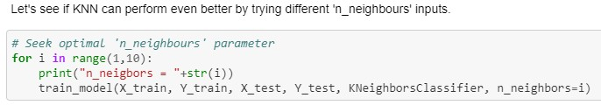
K-Nearest Neighbor

Slide 14
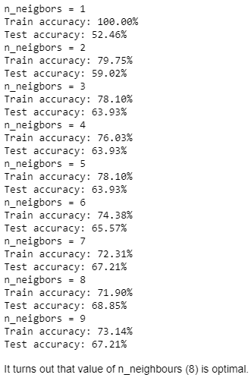
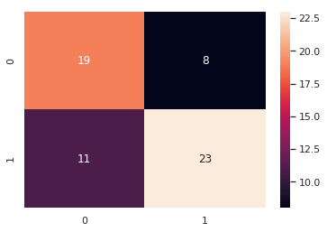
Precision: 0.74
Recall is: 0.67
F-Score: 0.70

Slide 15

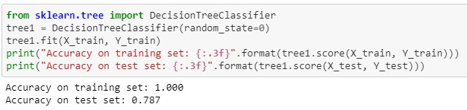
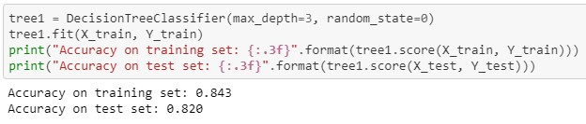
Decision Tree

Slide 16
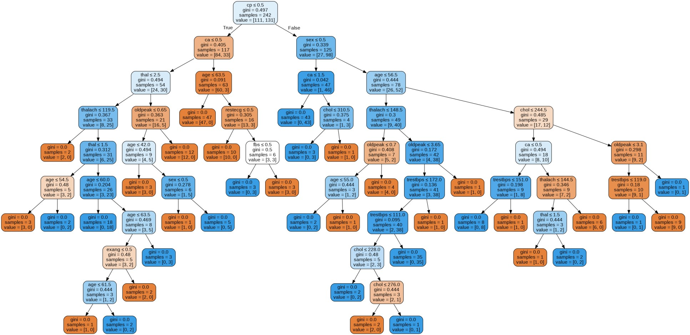
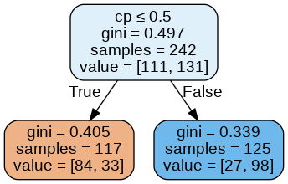

Slide 17
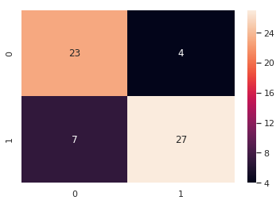
Precision: 0.87
Recall is: 0.79
F-Score: 0.83

Slide 18
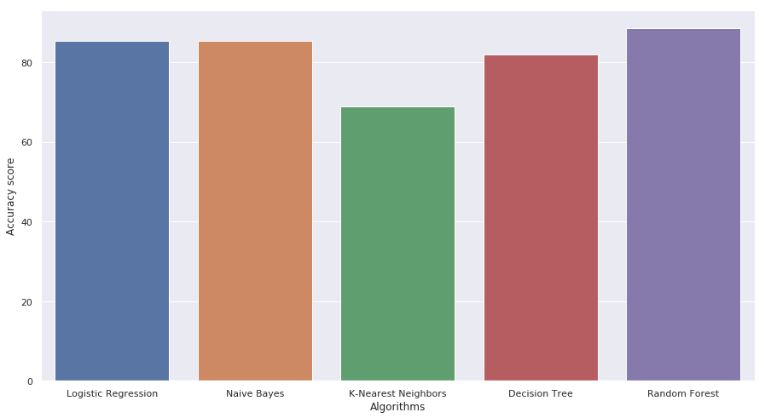
Results
85.24%
85.24%
68%
81.9%
88.52%

Slide 19
Business profit for heart disease prediction:
The business profit for heart disease prediction using machine learning can be significant, and here are some potential benefits for businesses in the healthcare industry:
1. Improved Patient Outcomes: Early detection and treatment of heart disease can significantly improve patient outcomes and reduce the risk of complications. By using machine learning models for heart disease prediction, healthcare providers can identify high-risk patients earlier and intervene promptly, leading to better patient outcomes and increased patient satisfaction.
2 Cost Savings: Machine learning models can help healthcare providers to allocate resources efficiently and effectively. By identifying high-risk patients early, healthcare providers can optimize their care delivery and reduce the need for costly hospitalizations and procedures. This can lead to significant cost savings for both patients and healthcare providers.
19

Slide 20
Conclusion:
In conclusion, heart disease prediction using machine learning has the potential to revolutionize the field of healthcare.
By analyzing large amounts of patient data, machine learning models can accurately predict the likelihood of developing heart disease and identify high-risk patients who may benefit from
early intervention.
20

Slide 21

21

